Slide 1
Windows Sysinternals技術報告

Slide 2
Agneda
Windows Sysinternals
Prpcess Explorer
Autoruns
Process Monitor
Proc Dump
學習心得

Slide 3
Process

Slide 4
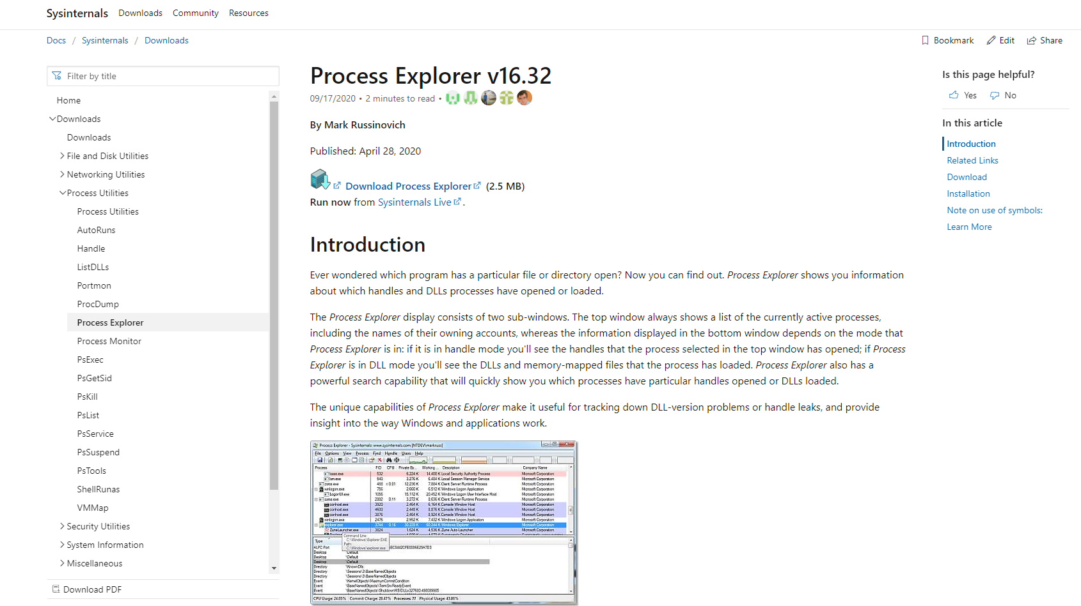

Slide 5
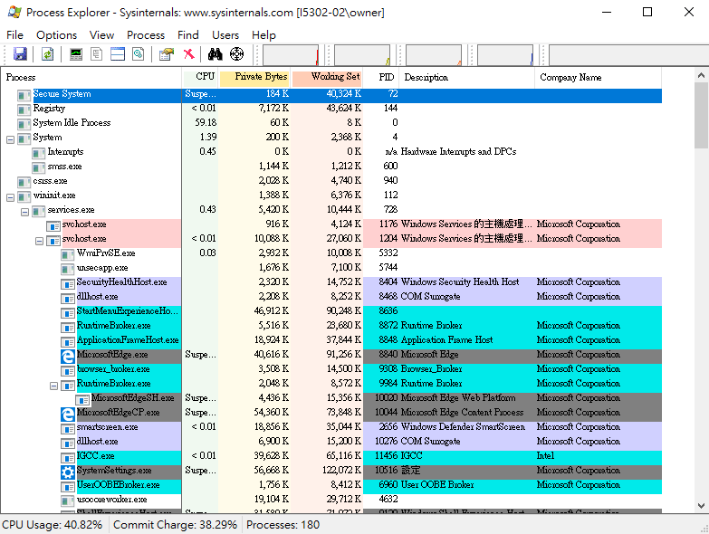

Slide 6
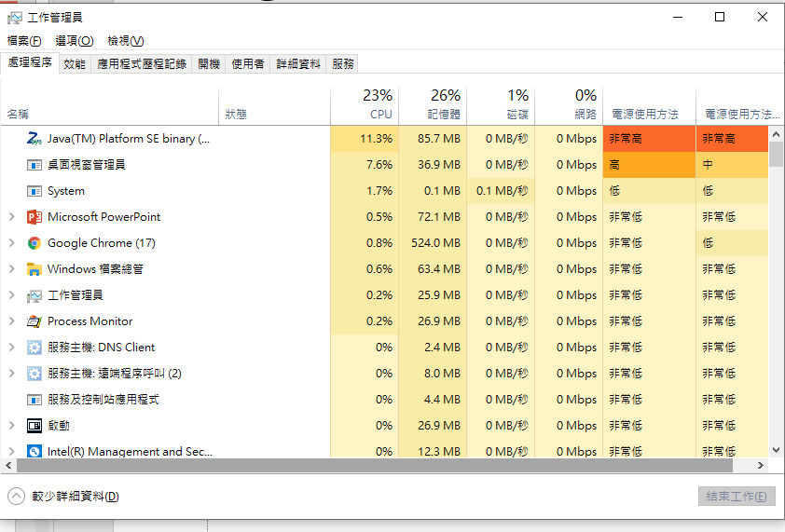

Slide 7
Process monitor

Slide 8
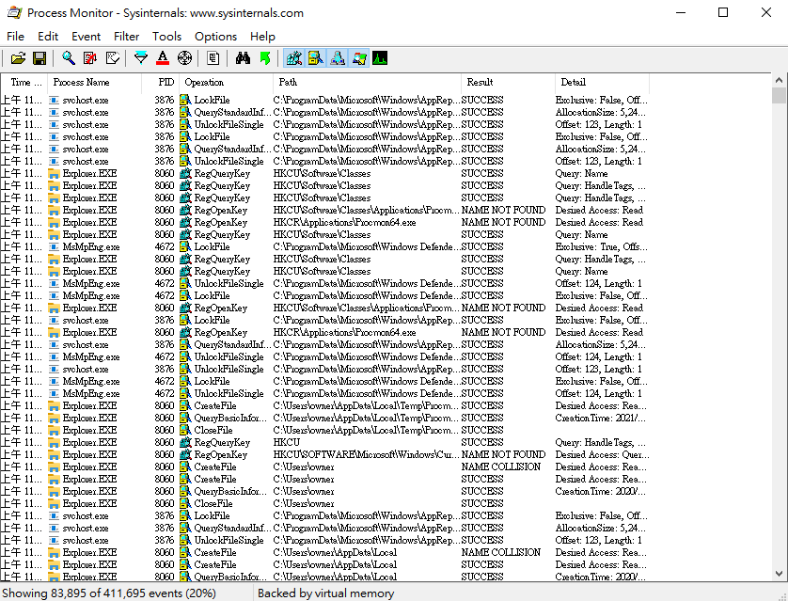
Process monitor

Slide 9
coreinfo

Slide 10
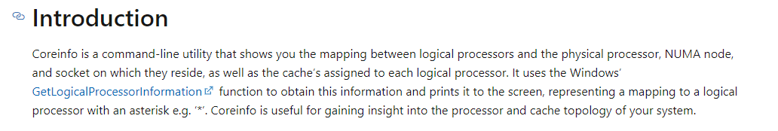

Slide 11
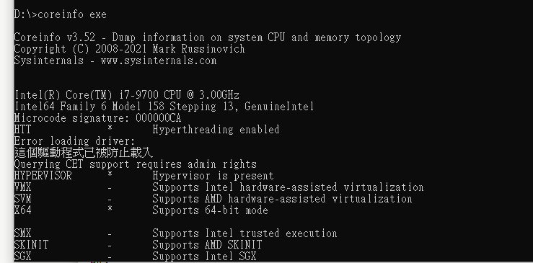

Slide 12
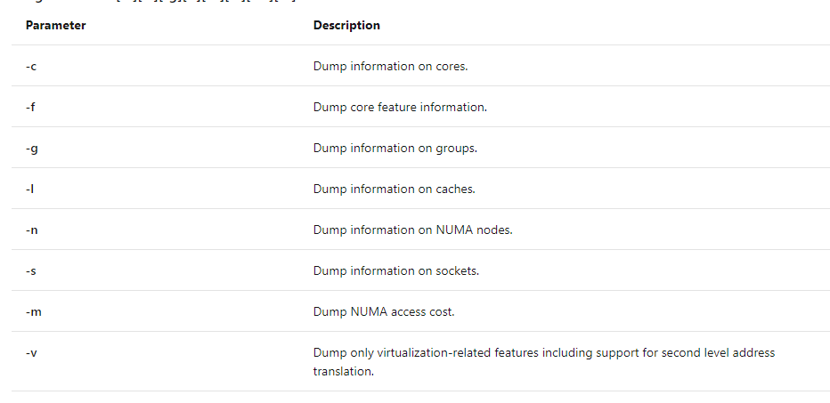

Slide 13
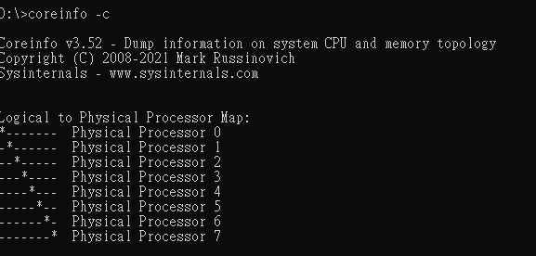

Slide 14
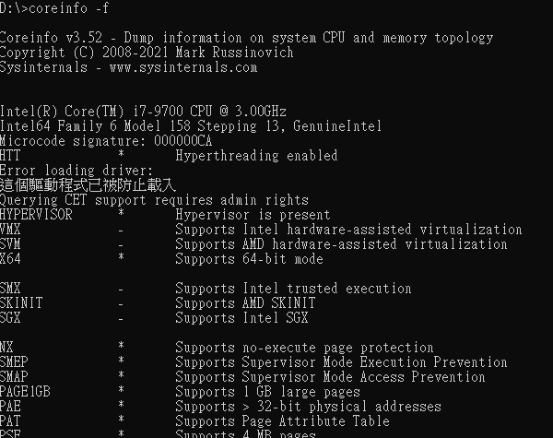

Slide 15
電腦管理

Slide 16
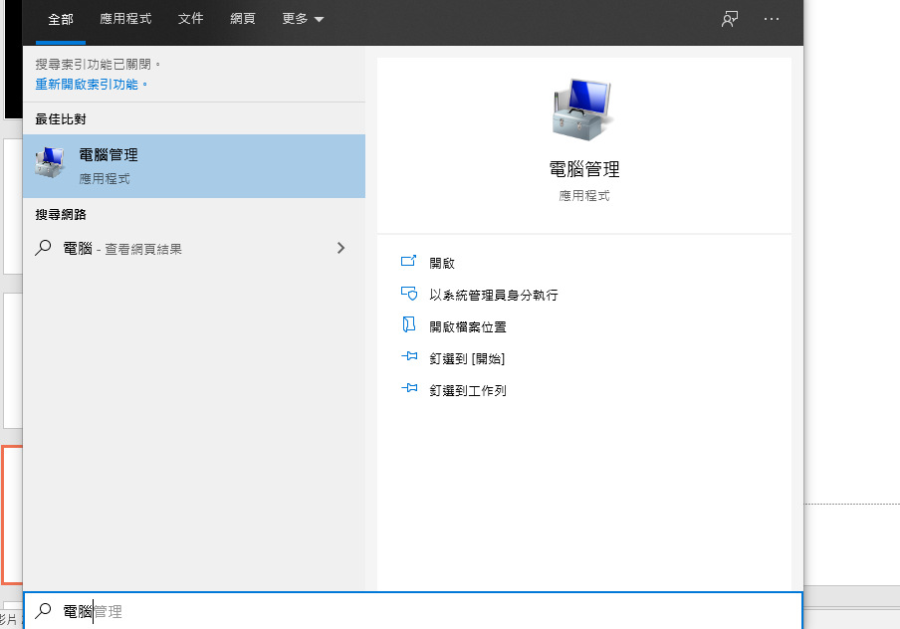

Slide 17
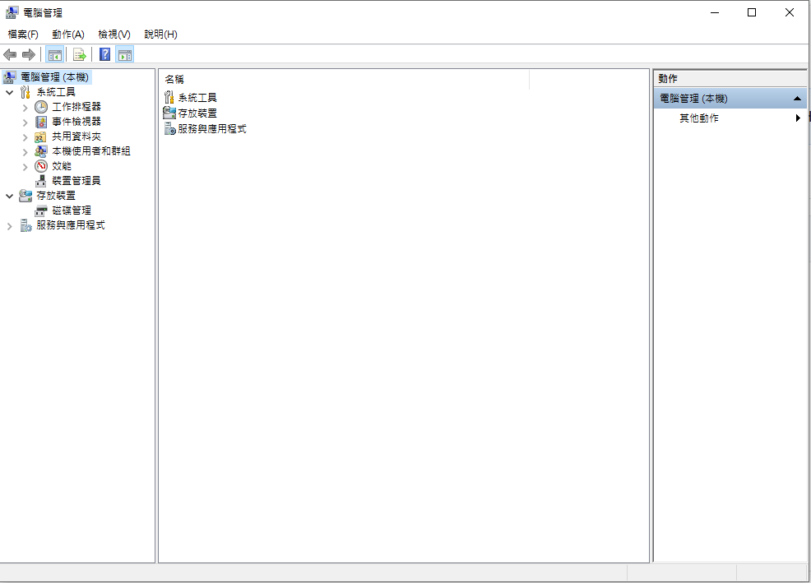

Slide 18
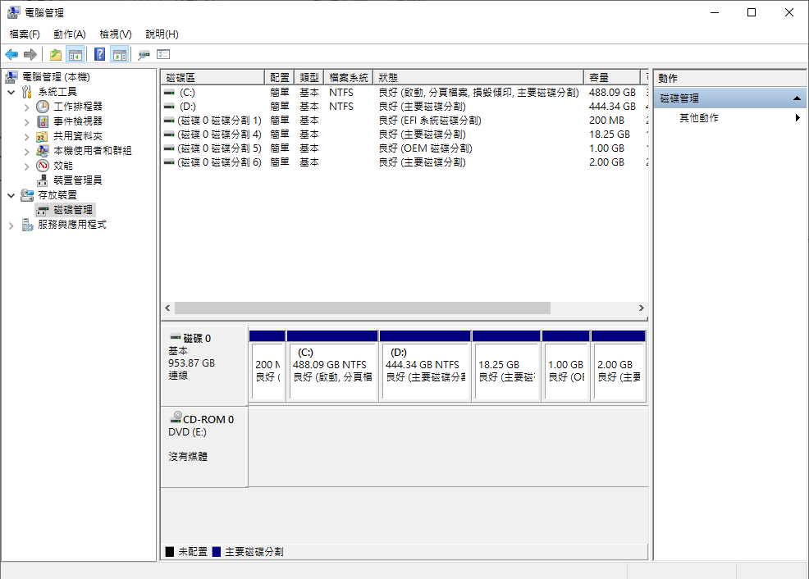

Slide 19
4

Slide 20
5

Slide 21
6

